Slide 1
Hospital Management System Using Node JS

Slide 2
Project Presentation
Submitted by:
1.Rajshri Thete
2. Sanchita Bhaktha
3. Manali Patil
4. Priti Yadav
Submitted To:
Mr.Anuj Kumar

Slide 3
Introduction
About Hospital Management System
A Hospital Management System (HMS) is a software solution that automates hospital operations like patient management, appointments, billing, pharmacy, and records. It improves efficiency, enhances patient care, and ensures data security while streamlining workflows.

Slide 4
Introduction
About Node JS
Node.js is an open-source, cross-platform, back-end JavaScript runtime environment that runs on the V8 engine and executes JavaScript code outside a web browser.

Slide 5
Requirement
Technology Used:
Front End: HTML, CSS, JavaScript, Handlebars.
Language: Node JS
Back End: MySQL

Slide 6
Requirement
Software configuration:
Operating system: Windows or Linux
Software: Visual studio code
Database: MySQL Database Service
Server: Apache HTTP Server
Hardware Configuration:
Processor: Intel Core i3 processor or higher
Hard Disk: Minimum 4 GB
RAM: 512 MB or more.
Network Connectivity.

Slide 7
FEATURES
Administrator
Login/Logout
Add Student
View Student Information
Edit Student Information
Delete Student Accounts
Search Students

Slide 8
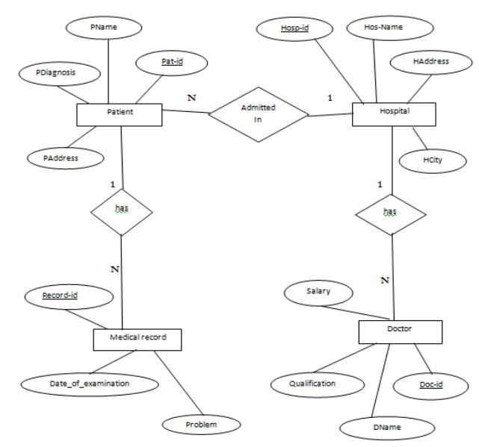
Entity Relation Model

Slide 9

Screenshots
Home Page

Slide 10
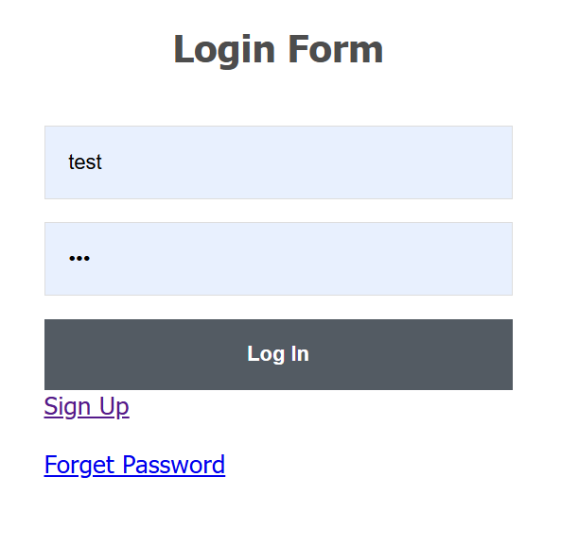
Screenshots
Login

Slide 11
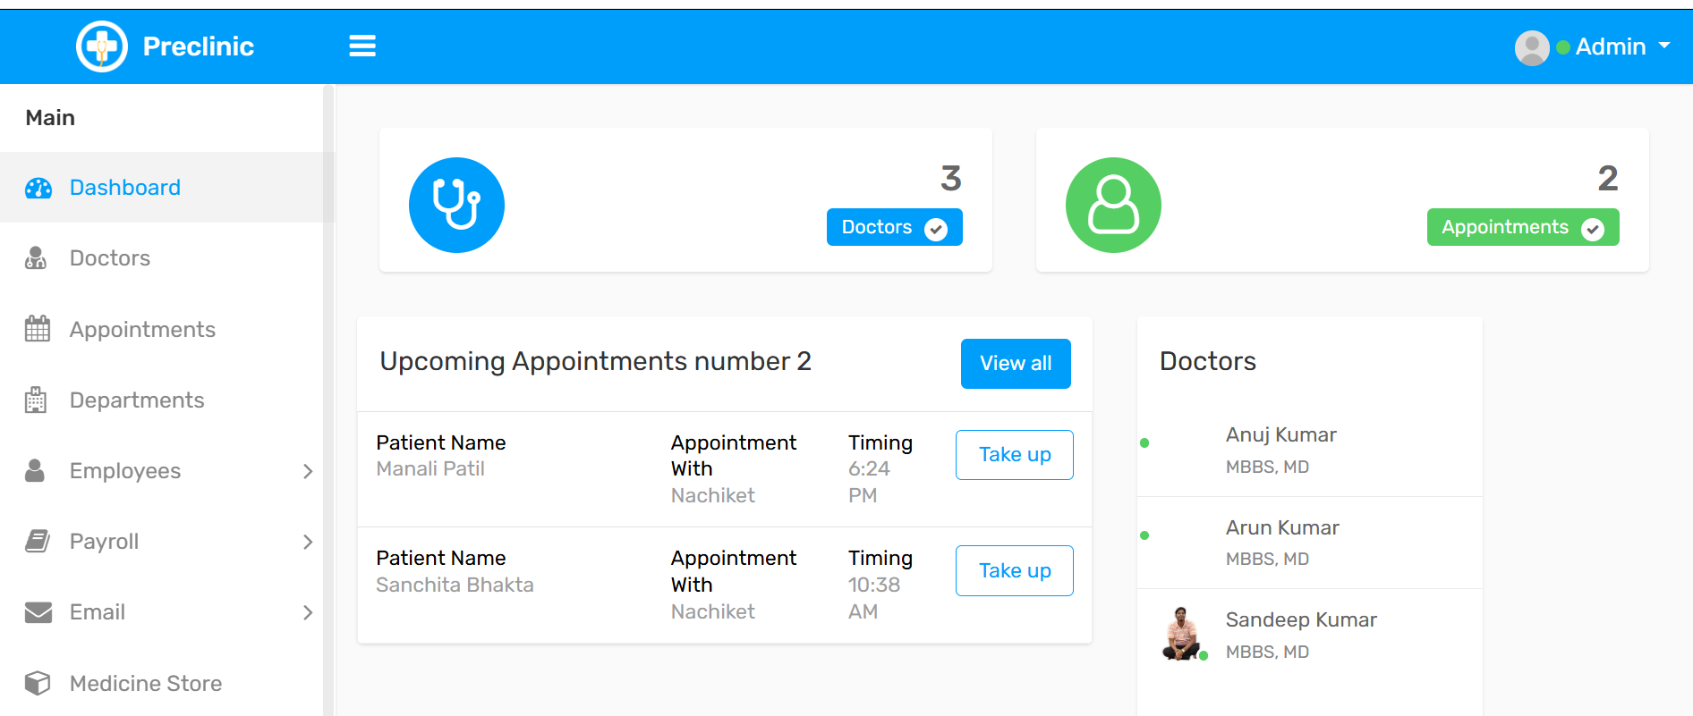
Home

Slide 12
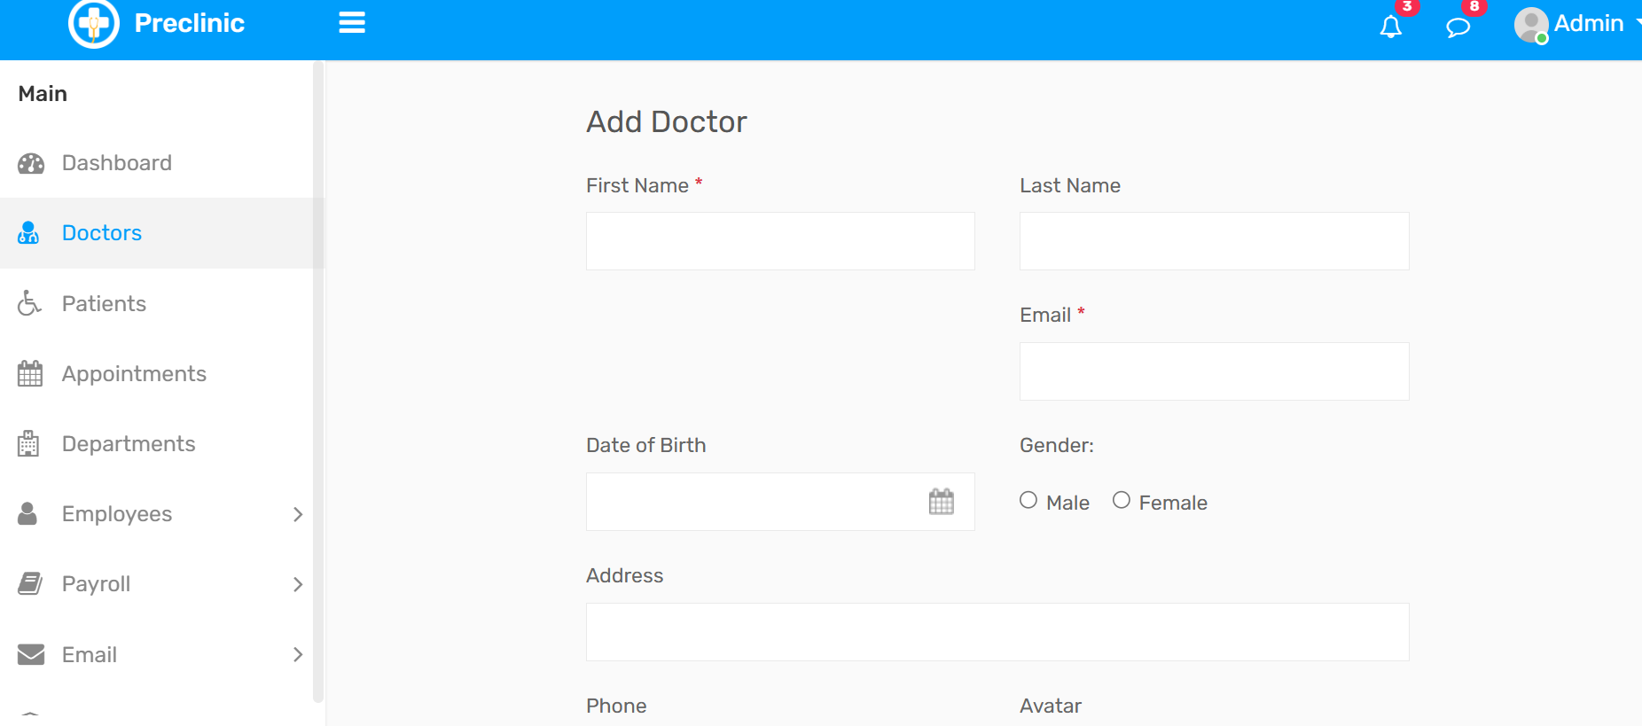
Add Doctor

Slide 13
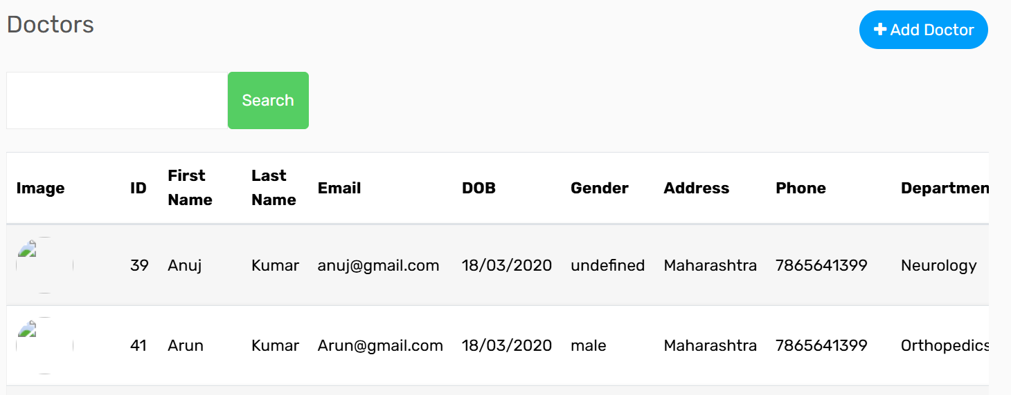
View Doctor

Slide 14
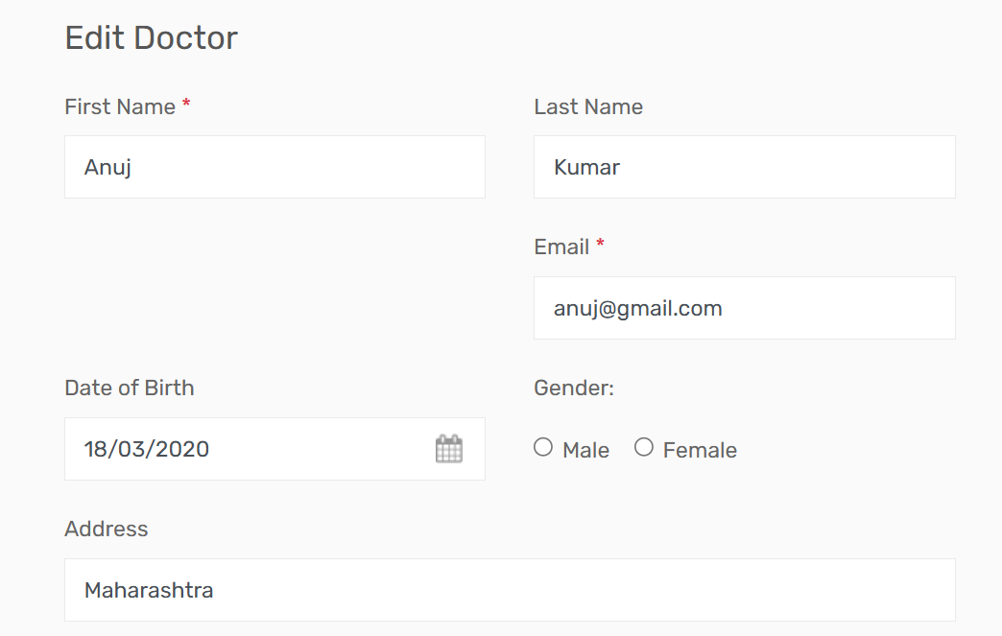
Edit Doctor

Slide 15
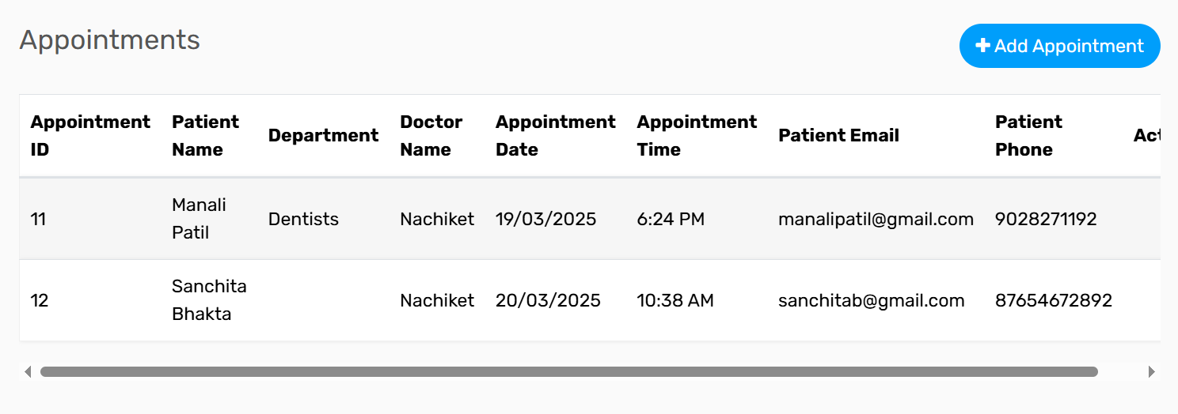
ADD APPOINTMENT

Slide 16
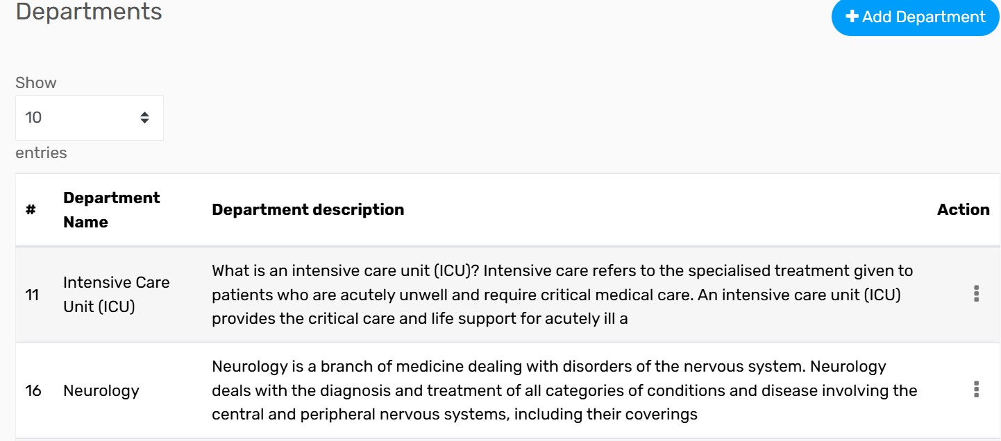
ADD DEPARTMENT

Slide 17
Conclusion
In conclusion, a well-designed Hospital Management System significantly enhances hospital operations, ensuring better patient care, operational transparency, and overall healthcare management efficiency.
As technology continues to evolve, incorporating advanced features like AI-driven diagnostics and cloud-based solutions will further revolutionize hospital management.

Slide 18
Thank You

